Slide 1
T-20 World Cup 2022 Data Analysis
AMGHAR HIND

Slide 2
Welcome to the T-20 World Cup 2022 Data Science project.

Slide 3
File Description :
T-20 World cup 2022.csv

Slide 4
IMPORT DATA
Python code to import necessary libraries and dataset
Displaying the first few rows of the dataset
Information about the dataset's columns and missing values

Slide 5
Column Meanings
Match Details:
match_id: Unique identifier for each match.
match_name: Name of the match (e.g., "ENG v PAK").
home_team: Team playing at home.
away_team: Team playing away.
current_innings: Indicates which team is currently batting (e.g., "PAK").
innings_id: Unique identifier for each innings within a match.
over: Current over being played (1-20).
ball: Ball number within the current over (1-6).

Slide 6
Column Meanings
Player Performance:
batsman1_id, batsman2_id: Unique identifiers for the two batsmen.
batsman1_name, batsman2_name: Names of the two batsmen.
batsman1_runs, batsman2_runs: Number of runs scored by each batsman.
batsman1_balls, batsman2_balls: Number of balls faced by each batsman.
bowler1_id, bowler2_id : Unique identifiers for the bowlers.
bowler1_name, bowler2_name : Names of the bowlers.
bowler1_overs, bowler2_overs : Number of overs bowled by each bowler.
bowler1_runs, bowler2_runs: Number of runs conceded by each bowler.
bowler1_wkts, bowler2_wkts: Number of wickets taken by each bowler.

Slide 7
Column Meanings
Match Events:
runs: Number of runs scored in that particular ball.
isBoundary: Indicates if the ball resulted in a boundary (four or six runs).
isWide, isNoball: Indicates if the ball was a wide or a no-ball.
wicket_id (if applicable): Unique identifier for a wicket (dismissal) event.
wkt_batsman_name (if applicable): Name of the batsman dismissed.
wkt_bowler_name (if applicable): Name of the bowler who took the wicket.
wkt_batsman_runs (if applicable): Number of runs scored by the dismissed batsman.
wkt_batsman_balls (if applicable): Number of balls faced by the dismissed batsman.
wkt_text (if applicable): Description of the wicket-taking event.
isRetiredHurt: Indicates if a batsman retired hurt.

Slide 8
Column Meanings
Commentary :
text: Commentary text associated with the ball or event.
preText, postText: Commentary text before and after the ball or event .

Slide 9
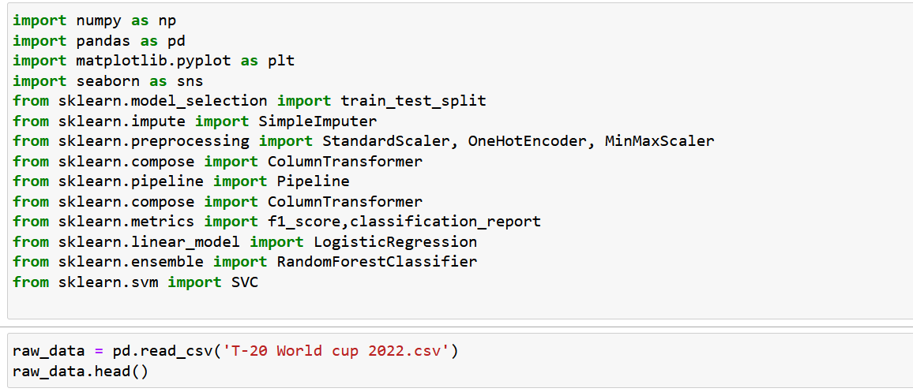
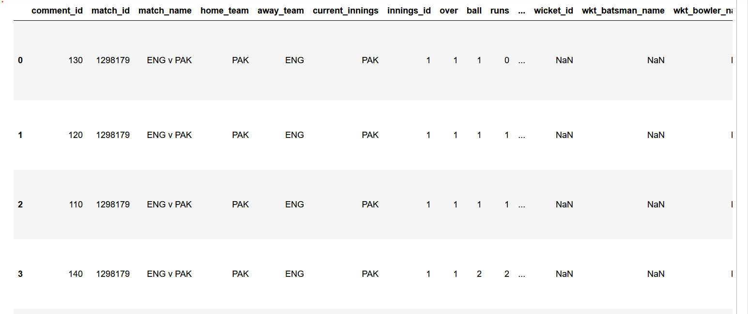
IMPORT NECESSARY LIBRARIES
DISPLAYING THE FIRST FEW ROWS OF THE DATASET

Slide 10

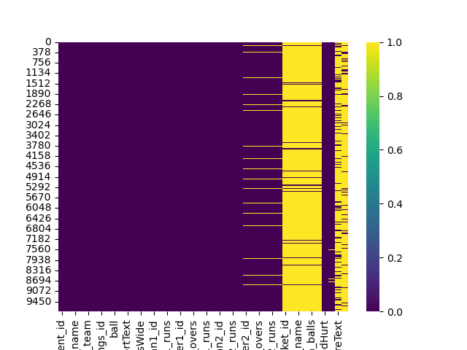
MISSING VALUES
there is a lot of null data in : wicket_id ,wkt_batsman_name ,wkt_bowler_name ,wkt_batsman_runs ,wkt_batsman_balls ,wkt_text

Slide 11
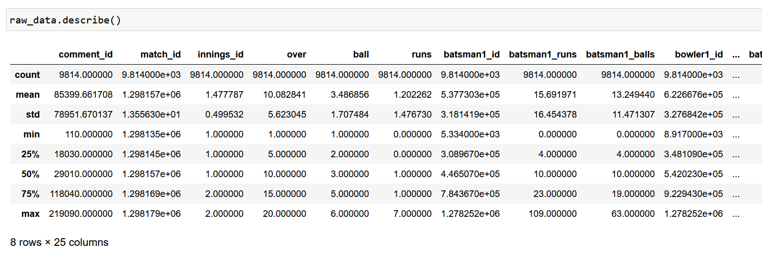
INFORMATION ABOUT THE DATASET

Slide 12
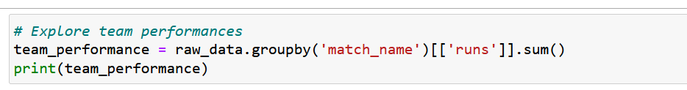
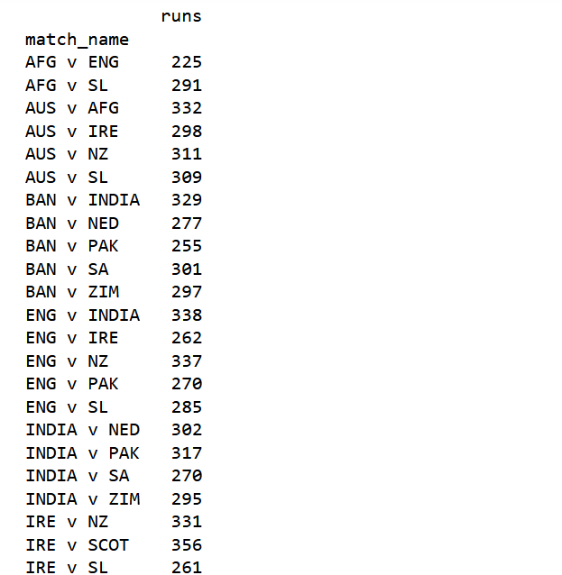
Data Exploration

Slide 13
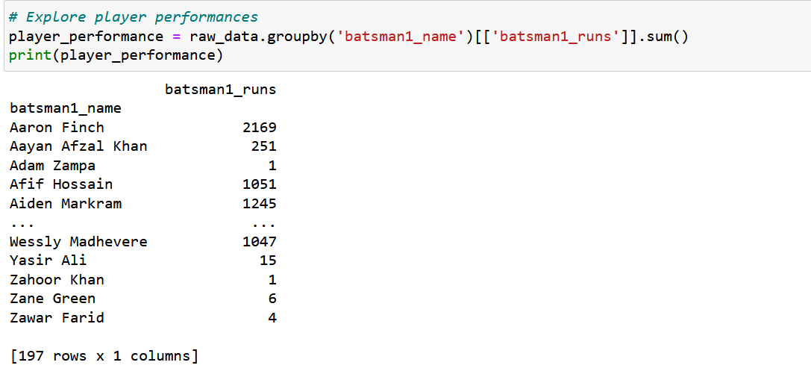
Data Exploration

Slide 14
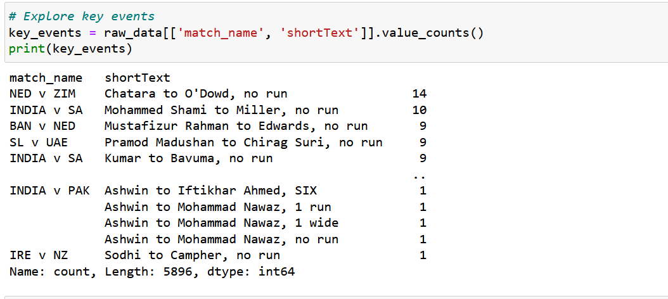
Data Exploration

Slide 15
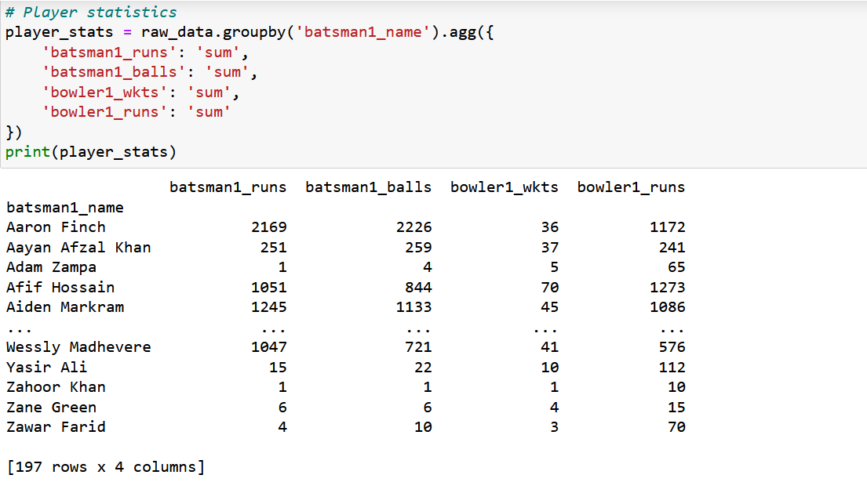
Data Exploration

Slide 16
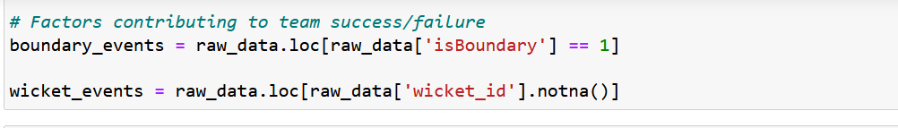
Data Exploration

Slide 17
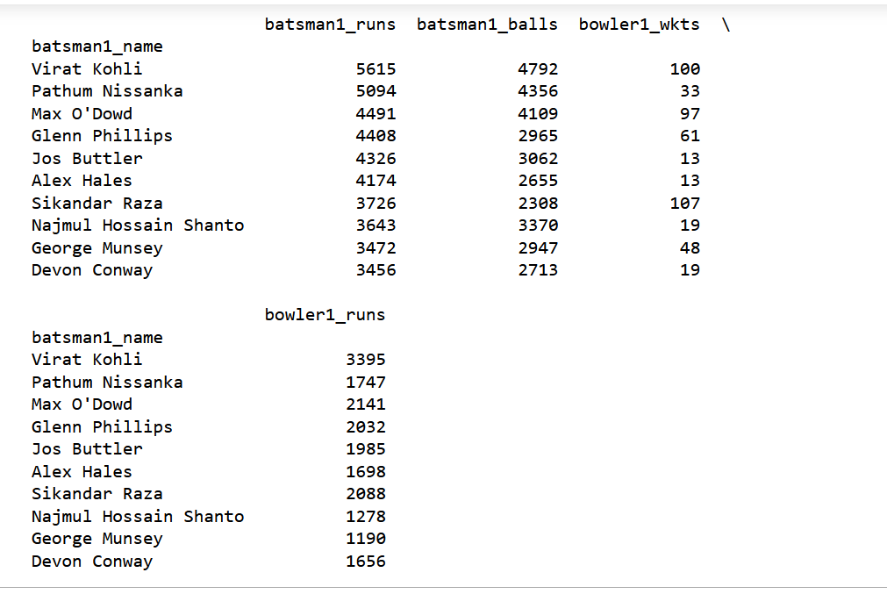
Data Exploration

Slide 18
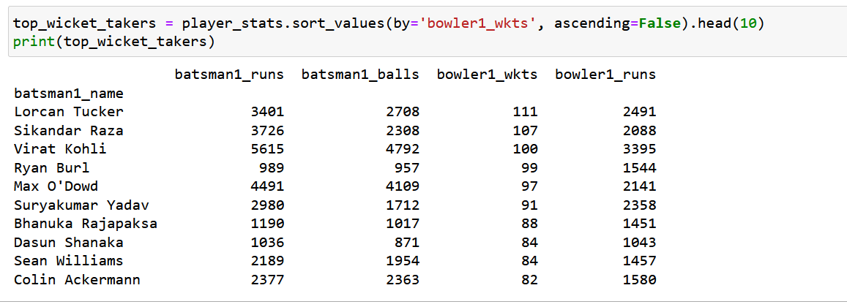
Data Exploration

Slide 19
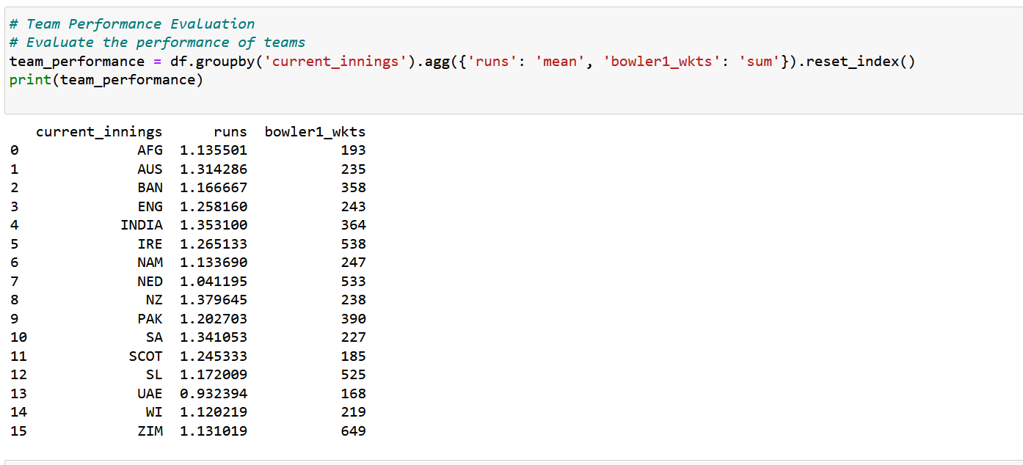
Data Exploration

Slide 20
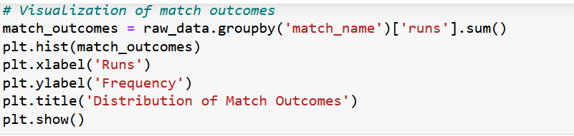
Data Exploration

Slide 21
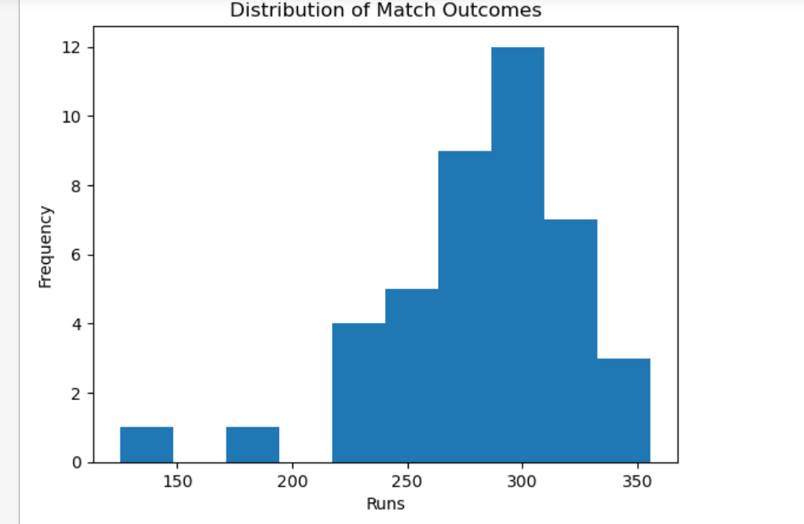
Data Exploration

Slide 22
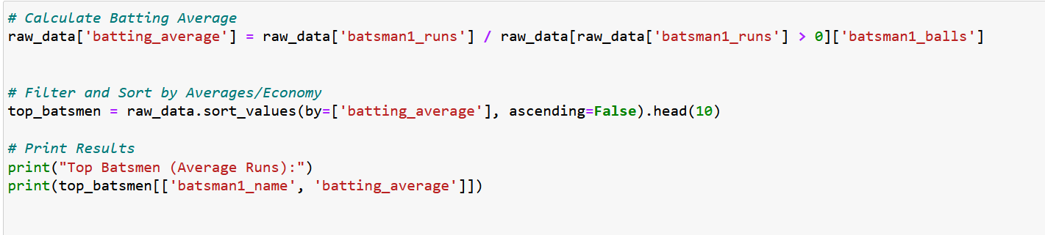
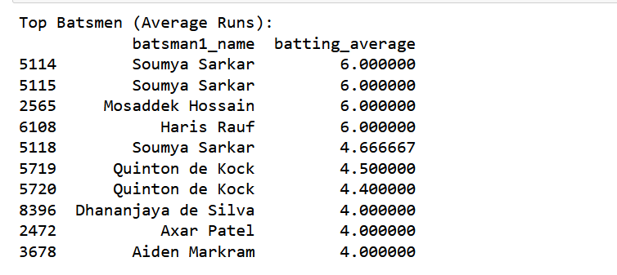
Data Exploration

Slide 23
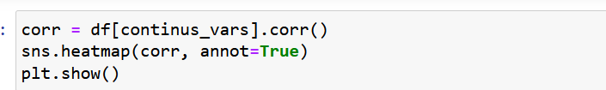
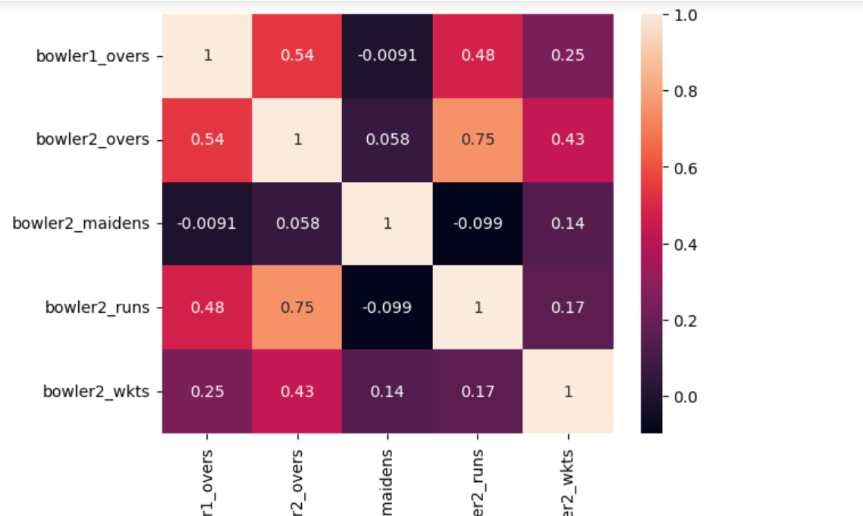
CORRELATION ANALYSIS

Slide 24
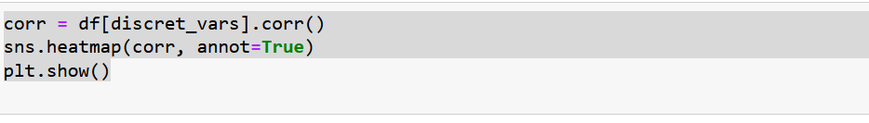
CORRELATION ANALYSIS

Slide 25
Objectif: machine learning workflow for classification tasks, specifically applied to the T-20 cricket match outcome prediction. Let's break down the steps:
Data Preparation:
Selected Features: Relevant features for prediction, including match-related information (home team, away team, current innings, innings ID, ball, etc.), player statistics (runs scored, balls faced, overs bowled, wickets taken, etc.), and derived features (batting average, bowling economy).
Data Selection: Only selected features are retained in the dataset data.
Preprocessing:
Separation of Features: Categorical and numerical features are separated based on their data types.
.

Slide 26
Preprocessing Steps: For numerical features, missing values are imputed with the median and then scaled using StandardScaler. For categorical features, missing values are imputed with the most frequent value, followed by one-hot encoding using OneHotEncoder.
ColumnTransformer: All preprocessing steps are combined into a single ColumnTransformer.
Modeling:
Pipeline Creation: A pipeline is created with preprocessing and model training steps.
Data Transformation: The data is transformed using the pipeline to preprocess it.
Data Splitting: The preprocessed data is split into training and testing sets.
Model Evaluation: Several classification models (Random Forest, Logistic Regression, SVM) are evaluated using cross-validation to find the best-performing model based on mean accuracy.
.

Slide 27
Model Evaluation:
Model Selection: The best-performing model is selected based on cross-validation results.
Model Training: The selected model (SVM) is trained on the training set.
Model Testing: The trained model is tested on the testing set to evaluate its performance.
Hyperparameter Tuning: Grid search is used to tune hyperparameters for the SVM model to further improve performance.
.

Slide 28
FEATURE ENGINEERING
Preprocessing steps for feature transformation and scaling
Code snippet demonstrating the use of pipelines and transformers
Splitting the dataset into training and validation sets
.

Slide 29
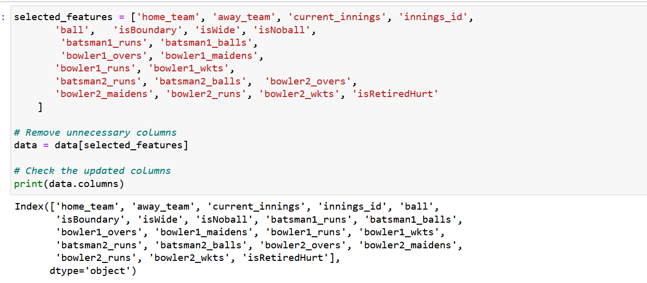
Features selection

Slide 30
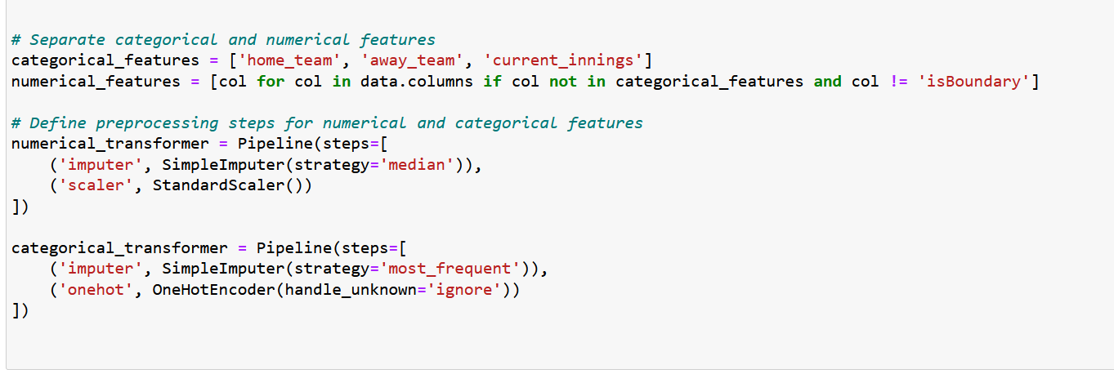
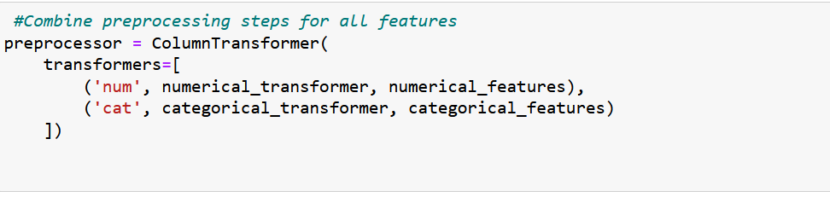
DATA PREPROCESSING PIPELINE

Slide 31
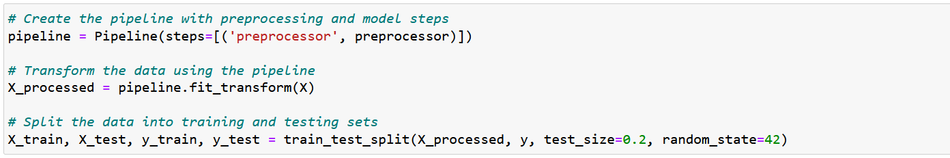
SPLITTING THE DATASET INTO TRAINING AND VALIDATION SETS

Slide 32
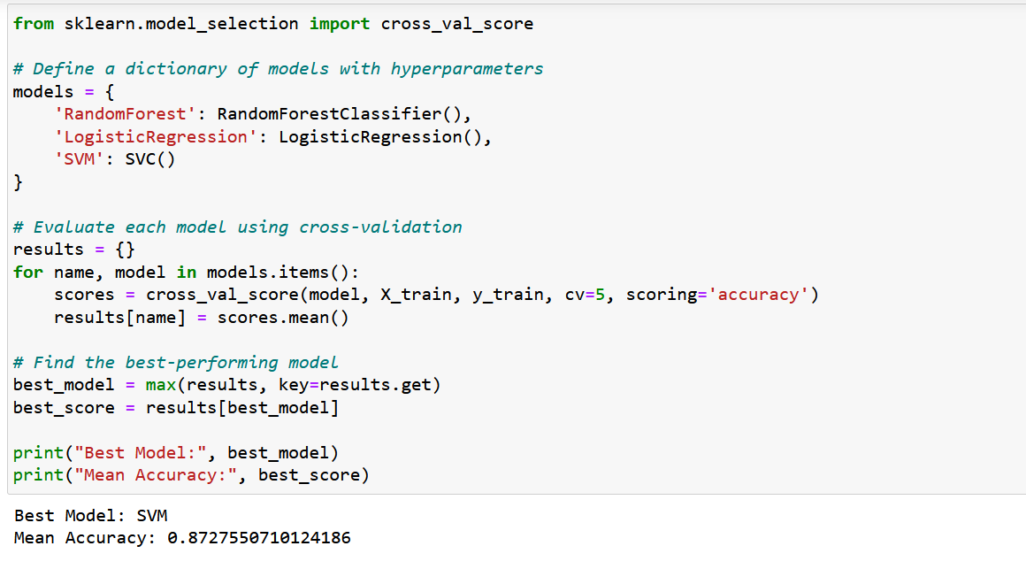
MODELING

Slide 33

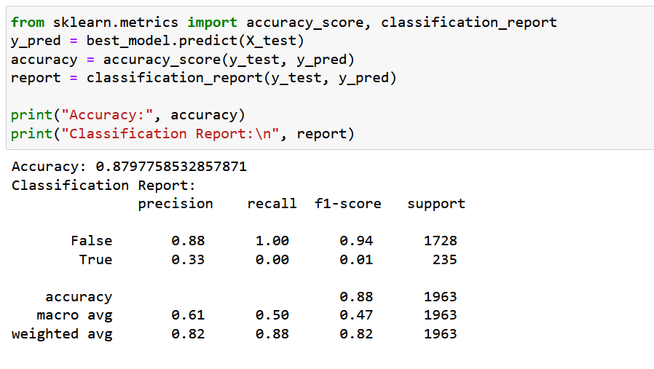
MODEL EVALUATION

Slide 34
MODEL EVALUATION

Slide 35
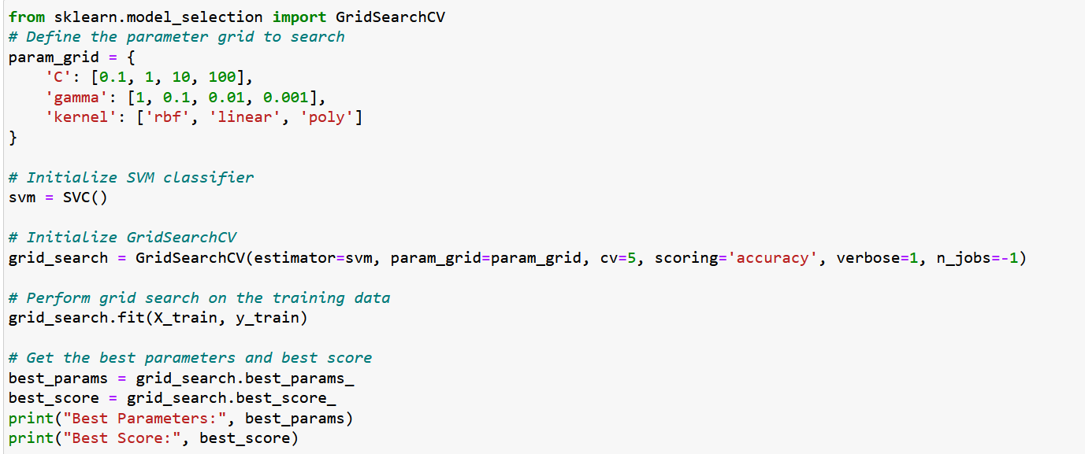
MODEL EVALUATION

Slide 36
Thank you

